Slide 1

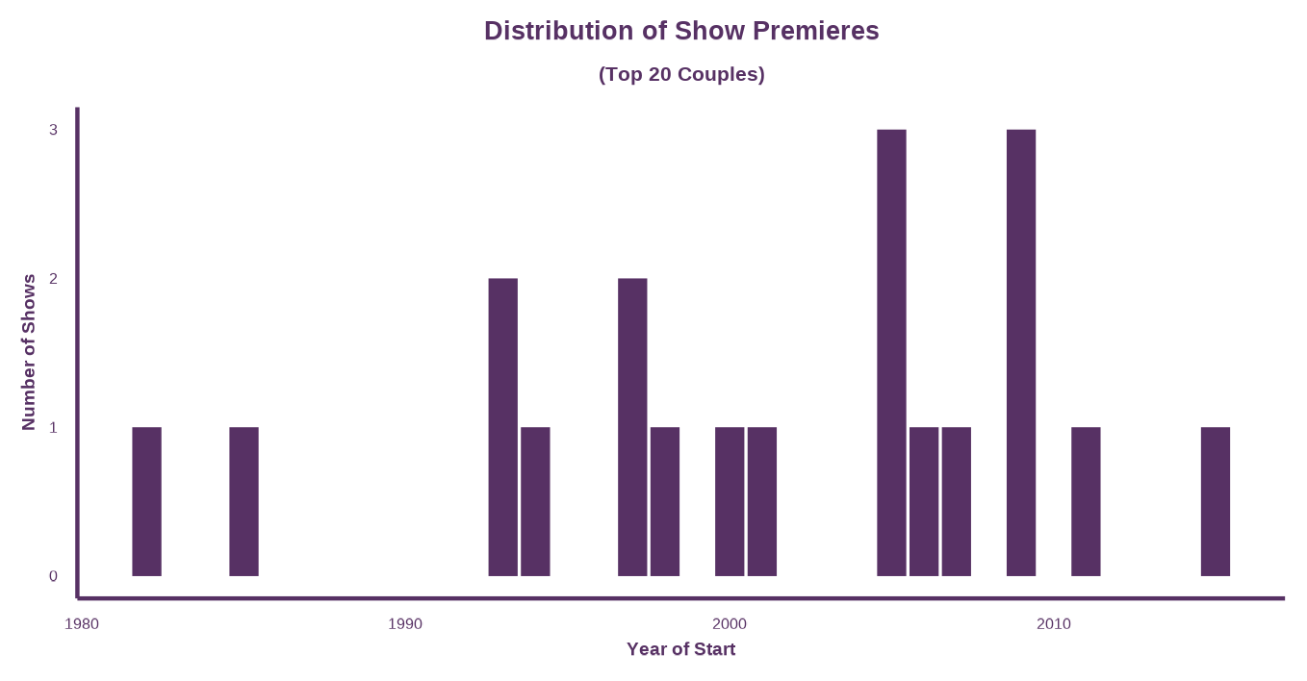
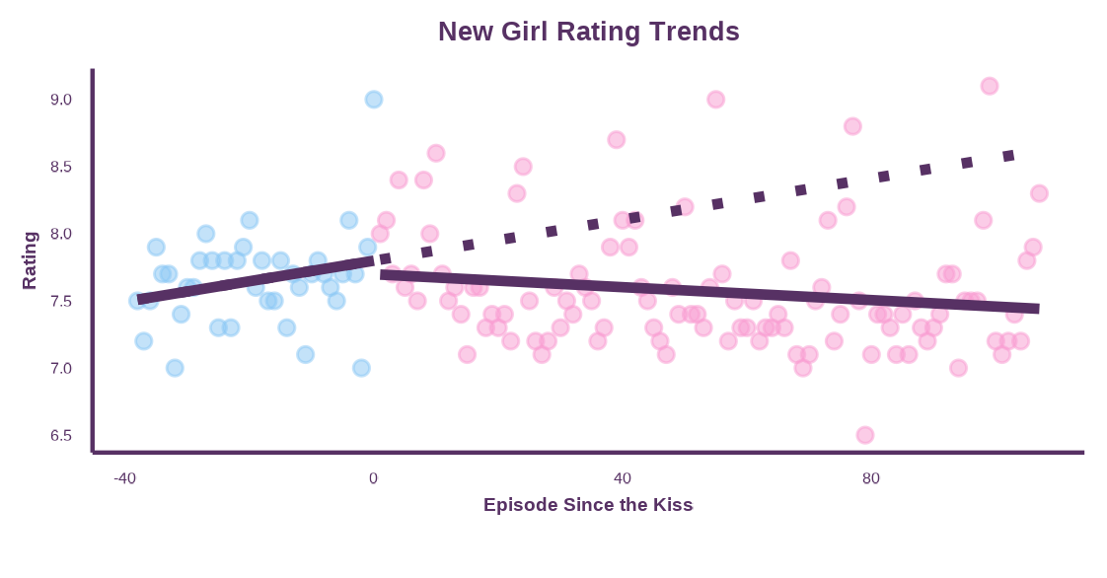
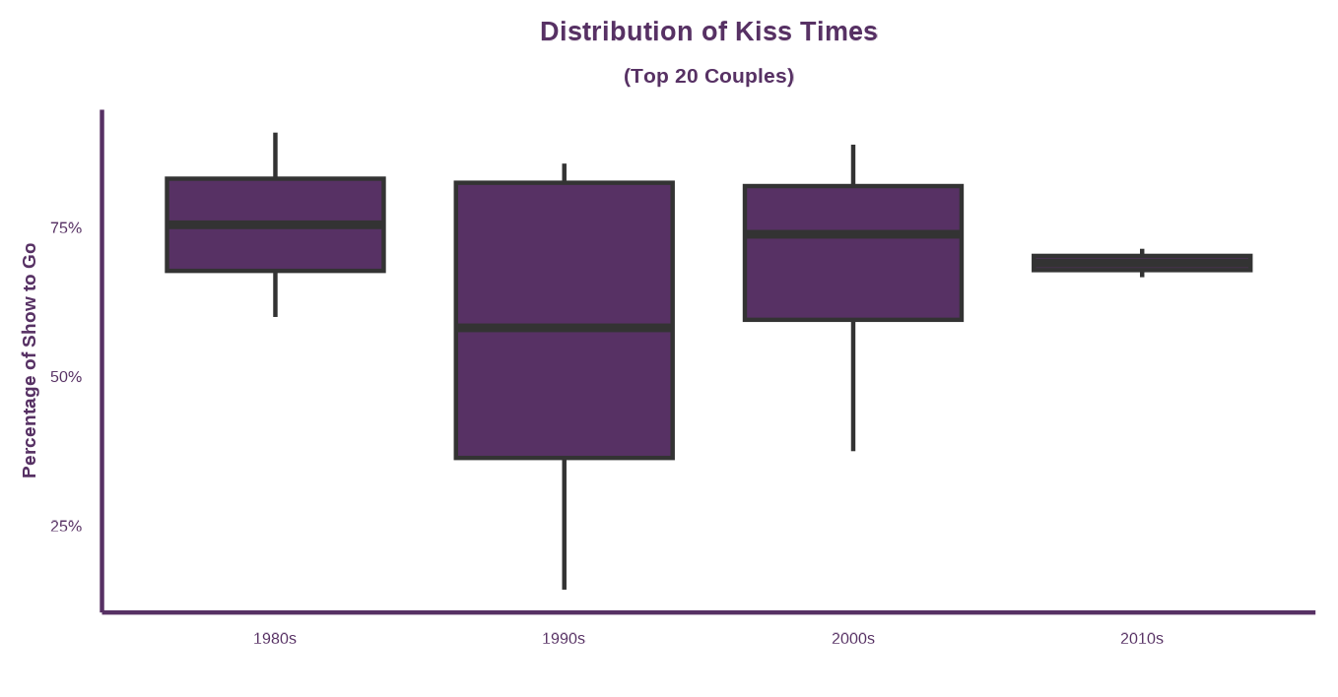
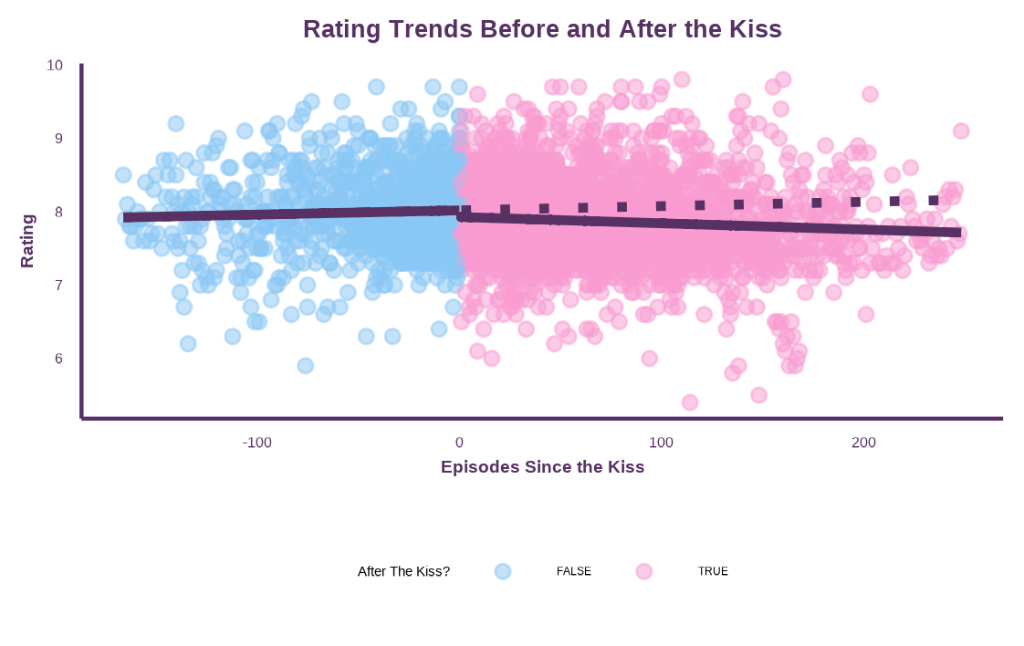

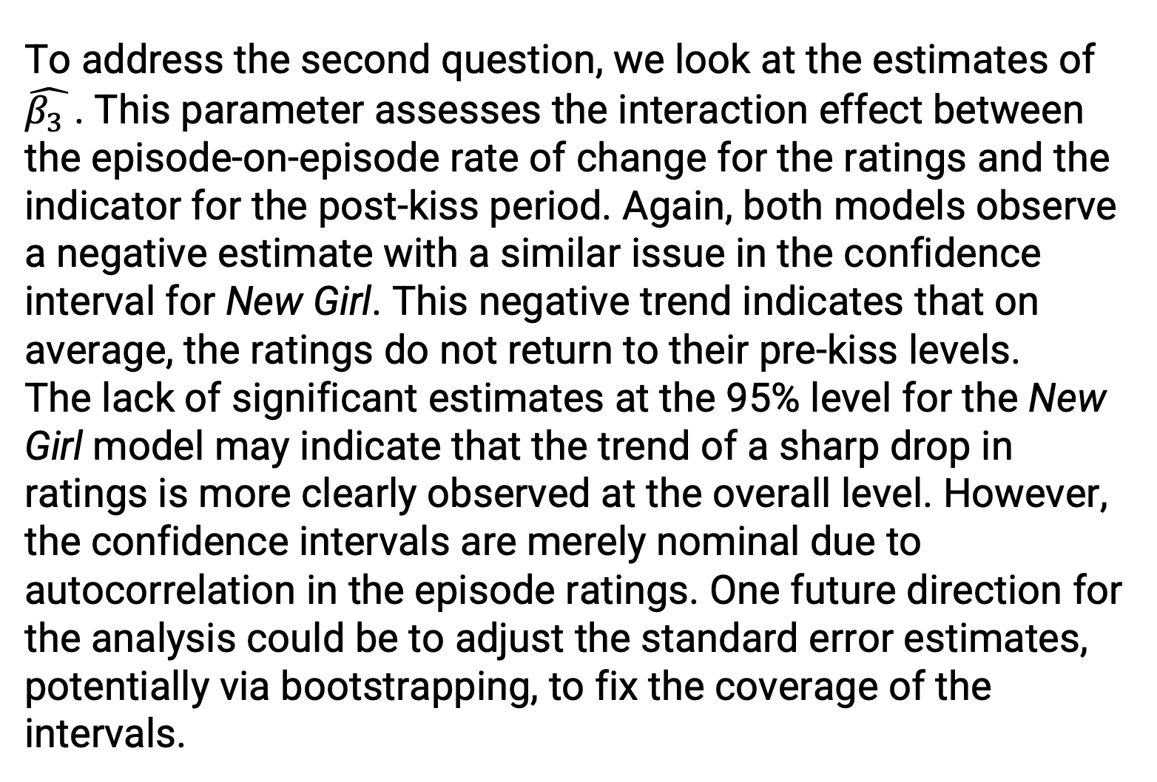
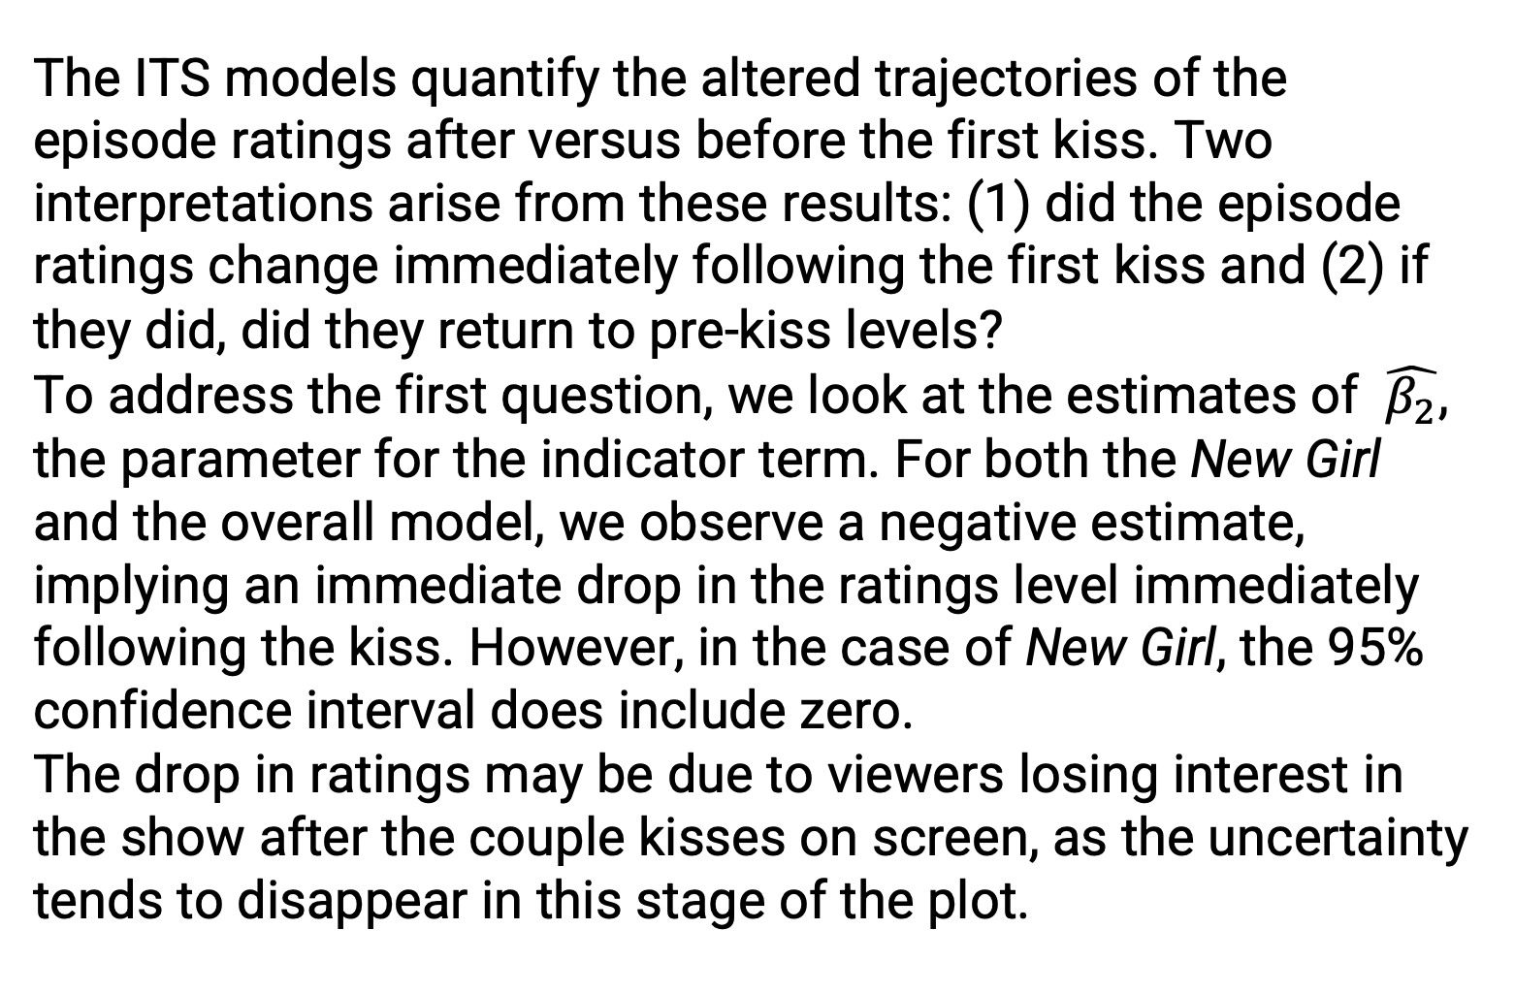
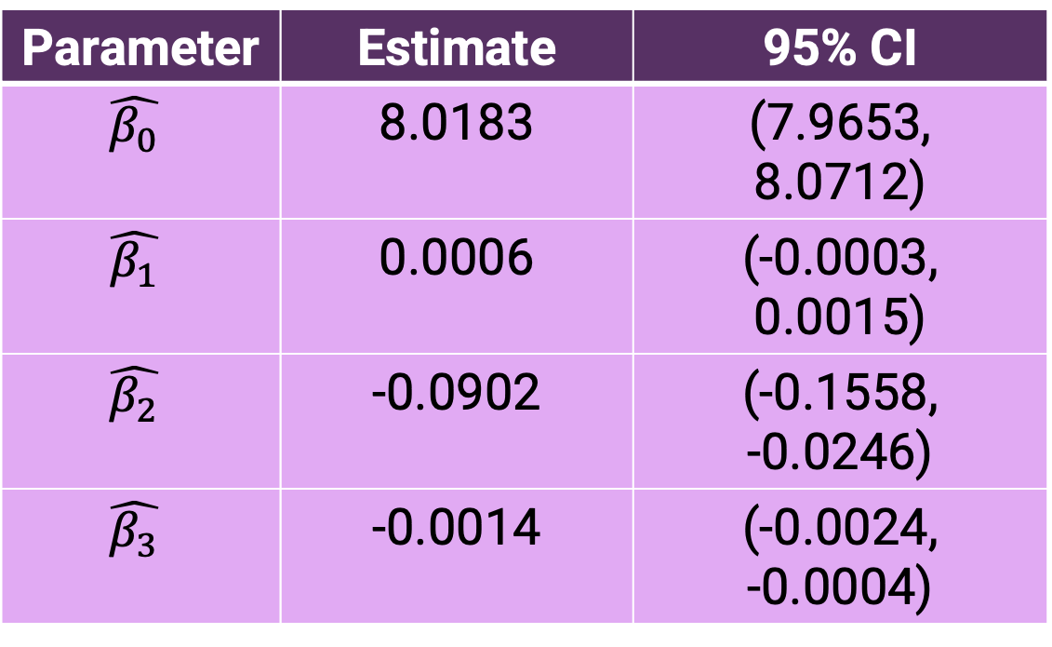

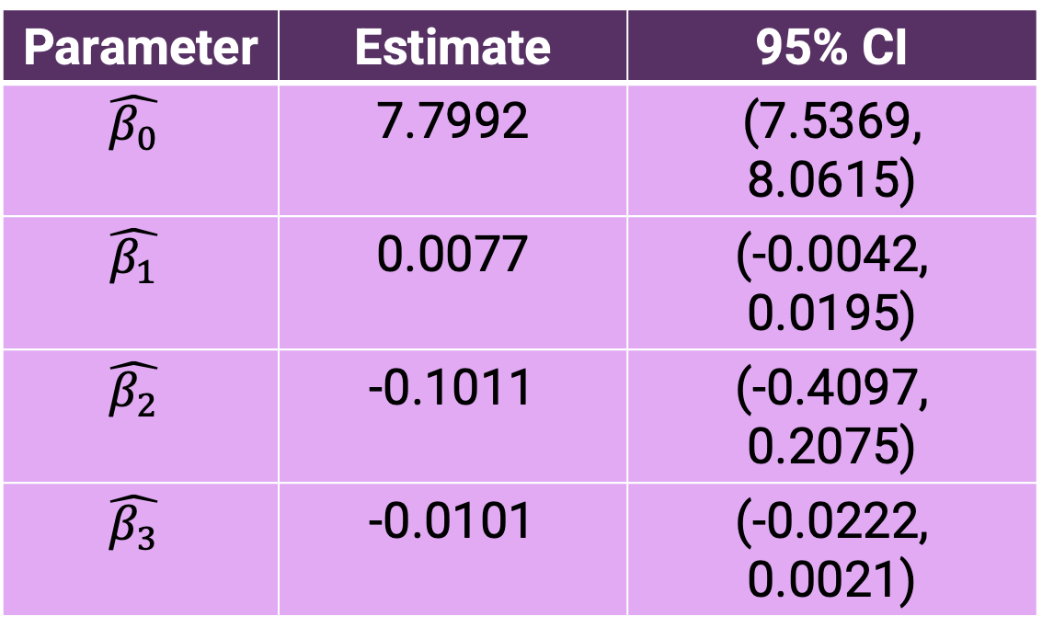
Rate This Interruption: Using Interrupted Time Series Techniques to Analyze Popular Television Couples and Episode Ratings
Ashley E. Mullan₁, Lucy D’Agostino McGowan₁, Sarah C. Lotspeich₁
1. Wake Forest University
Winston-Salem, North Carolina
USA
INTRODUCTION
RESULTS
Many television shows follow the “will they or won’t they” trope, where the dynamic between a pair of
main characters constantly shifts between friendship and something more throughout the run of the series. The couple clearly demonstrates romantic chemistry, but their future is plagued by uncertainty and a combination of internal and external conflict.¹ This trope has persisted throughout the decades, and examples include Sam and Diane from the 1980s show Cheers and Jess and Nick from the 2010s show New Girl. In some cases, the audience may wait multiple
seasons before a couple like this gets together, and some suspect that producers delay the moment to create
suspense and keep viewers engaged. Events marking major romantic milestones, such as the pair’s first kiss,
often change the trajectory of the plot, influence the number of viewers tuning into the show, and impact
episode ratings. We propose an interrupted time series model to examine the direction and magnitude of the causal effect of a couple’s first kiss on a show’s ratings.
Table 1: Parameter Estimates – New Girl
Parameter | Estimate | 95% CI
$$\hat{β_{0}}$$ | 7.7992 | (7.5369, 8.0615)
$$\hat{β_{1}}$$ | 0.0077 | (-0.0042, 0.0195)
$$\hat{β_{2}}$$ | -0.1011 | (-0.4097, 0.2075)
$$\hat{β_{3}}$$ | -0.0101 | (-0.0222, 0.0021)
Figure 1: Distribution of Show Premieres
The trope persists from as early as the 1980s to today.
Figure 3: ITS Model Results
After the first kiss airs, the ratings decrease on average. This trend persists both at the show level (above) and overall (below).
Table 2: Parameter Estimates – Overall
METHODS
Parameter | Estimate | 95% CI
$$\hat{β_{0}}$$ | 8.0183 | (7.9653, 8.0712)
$$\hat{β_{1}}$$ | 0.0006 | (-0.0003, 0.0015)
$$\hat{β_{2}}$$ | -0.0902 | (-0.1558, -0.0246)
$$\hat{β_{3}}$$ | -0.0014 | (-0.0024, -0.0004)
Data
Through publicly available TV couple rankings, 137 “will they or won’t they” couples from 108 shows were identified. Data about each couple-show pairing was then scraped from the Internet Movie Database (IMDb)³ and Wikipedia⁴. Variables of interest include the timing of the first kiss, the couples’ internet popularity, the number of seasons, the year of premiere, and episode ratings.
Analysis
Exploratory data analysis was conducted to visualize the distributions of when the shows premiered and when the couples’ kisses occurred. A variable was then created to track how many episodes had occurred since the first kiss event. The data was subset to consider one specific couple, Jess and Nick from New Girl. To assess the hypothesis of a sharp change in both the level and slope of the ratings trend after the first kiss, the following interrupted time series model was fit. Y_{t} represents the rating for episode t, and I(t > k) is an indicator variable measuring whether the episode airs after the one with the first kiss, episode k.
$$Y_{t}= β_{0}+β_{1}t+β_{2}I\left(t>k\right)+β_{3}tI(t>k)$$
The same model was then fit to the top 20 most popular couples, the only ones for which full ratings data could be compiled.
Figure 2: Distribution of Kiss Times
Except those premiering in the 1990s, most of the shows chose to cut the trope short. The median couple for each decade has their first kiss with over two thirds of the show left to go.
DISCUSSION AND CONCLUSION
REFERENCES
The ITS models quantify the altered trajectories of the episode ratings after versus before the first kiss. Two interpretations arise from these results: (1) did the episode ratings change immediately following the first kiss and (2) if they did, did they return to pre-kiss levels?
To address the first question, we look at the estimates of $\hat{β_{2}}$, the parameter for the indicator term. For both the New Girl and the overall model, we observe a negative estimate, implying an immediate drop in the ratings level immediately following the kiss. However, in the case of New Girl, the 95% confidence interval does include zero.
The drop in ratings may be due to viewers losing interest in the show after the couple kisses on screen, as the uncertainty tends to disappear in this stage of the plot.
To address the second question, we look at the estimates of $\hat{β_{3} }$. This parameter assesses the interaction effect between the episode-on-episode rate of change for the ratings and the indicator for the post-kiss period. Again, both models observe a negative estimate with a similar issue in the confidence interval for New Girl. This negative trend indicates that on average, the ratings do not return to their pre-kiss levels.
The lack of significant estimates at the 95% level for the New Girl model may indicate that the trend of a sharp drop in ratings is more clearly observed at the overall level. However, the confidence intervals are merely nominal due to autocorrelation in the episode ratings. One future direction for the analysis could be to adjust the standard error estimates, potentially via bootstrapping, to fix the coverage of the intervals.
1. https://en.wiktionary.org/wiki/will-they-won%27t-they
2. https://pubmed.ncbi.nlm.nih.gov/27283160/
3. https://www.imdb.com/
4. https://www.wikipedia.org/
Notes:
How to best cite all the sources. Sentence about them living in the QR code? Which does need to be fixed LOL

Slide 2
HEADING HERE
Poster Presenter₁, Author Two₁, Author Three₂, Author Four₃
1. Institution One, Location, Country,
2. Institution Two, Location, Country,
3. Institution Three, Location, Country
Logo goes here
INTRODUCTION
RESULTS
Introduction text
Results text
Figure 3: Title of figure
Caption
METHODS
Figure 2: Title of figure
Caption
Results text
Figure 1: Title of figure
Caption
DISCUSSION AND CONCLUSION
REFERENCES
Discussion/Conclusion text
Discussion/Conclusion text
References/acknowledgements s+ optional QR code

Slide 3
HEADING FONT
Subheading font
ONE PANEL WIDTH
TWO PANEL WIDTH
Colour palette
ONE PANEL WIDTH
TWO PANEL WIDTH
ONE PANEL WIDTH
TWO PANEL WIDTH
ONE PANEL WIDTH
TWO PANEL WIDTH
ONE PANEL WIDTH
TWO PANEL WIDTH
One panel width text box + optional background colour
Two panel width text box + optional background colour
Two panel width text box + optional background colour
Figure Box: Title of figure
Caption
THREE PANEL WIDTH
THREE PANEL WIDTH
THREE PANEL WIDTH
THREE PANEL WIDTH
THREE PANEL WIDTH
Three panel width text box + optional background colour
Three panel width text box + optional background colour
Three panel width text box + optional background colour

